Slide 1
Technology Tools
to Save Time/Money
Scott Fox
Director of Technology
Palos School District 118
sfox@palos118.org
Eric Nush
Network/System Administrator
Palos School District 118
enush@palos118.org

Slide 2
About Us
Palos School District 118 in Palos Park, IL
~45 Min South of Chicago
PreK-8, 2,500 Students
Two Elementary Schools (PreK-5), One Middle School (6-8)
Admin Building, Transportation/Operations Building
Windows School District, 1:1 in our Middle School
Most Servers and Services On Site
Fiber WAN to all buildings, Fiber ISP from WOW

Slide 3
Monitis
Cloud based monitoring
PRTG onsite, Monitis monitors our ISP and public IPs
If our ISP is down, we would not get notifications from PRTG
Sends emails/texts to non-district accounts
Free Plan!
Up to 5 monitors, checks every 15 minutes from 2 different locations
We monitor our firewall and our email server
1 Full Page Website Load Time Check, every 60 min
1 Server Check, every 30 min

Slide 4
Uptime Robot
Cloud based monitoring
Free Plan!
Up to 50 monitors, checks every 5 minutes

Slide 5
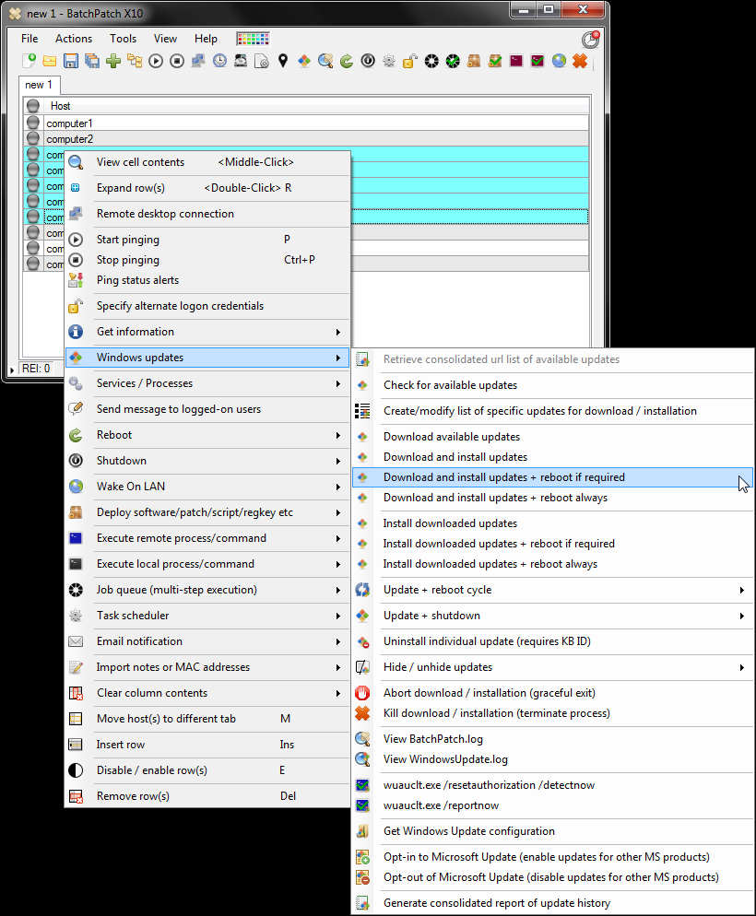
BatchPatch
Mass Windows Update Tool
Can Cache/Offline Update Computers
Can use Microsoft Update or WSUS
$400 one-time cost

Slide 6
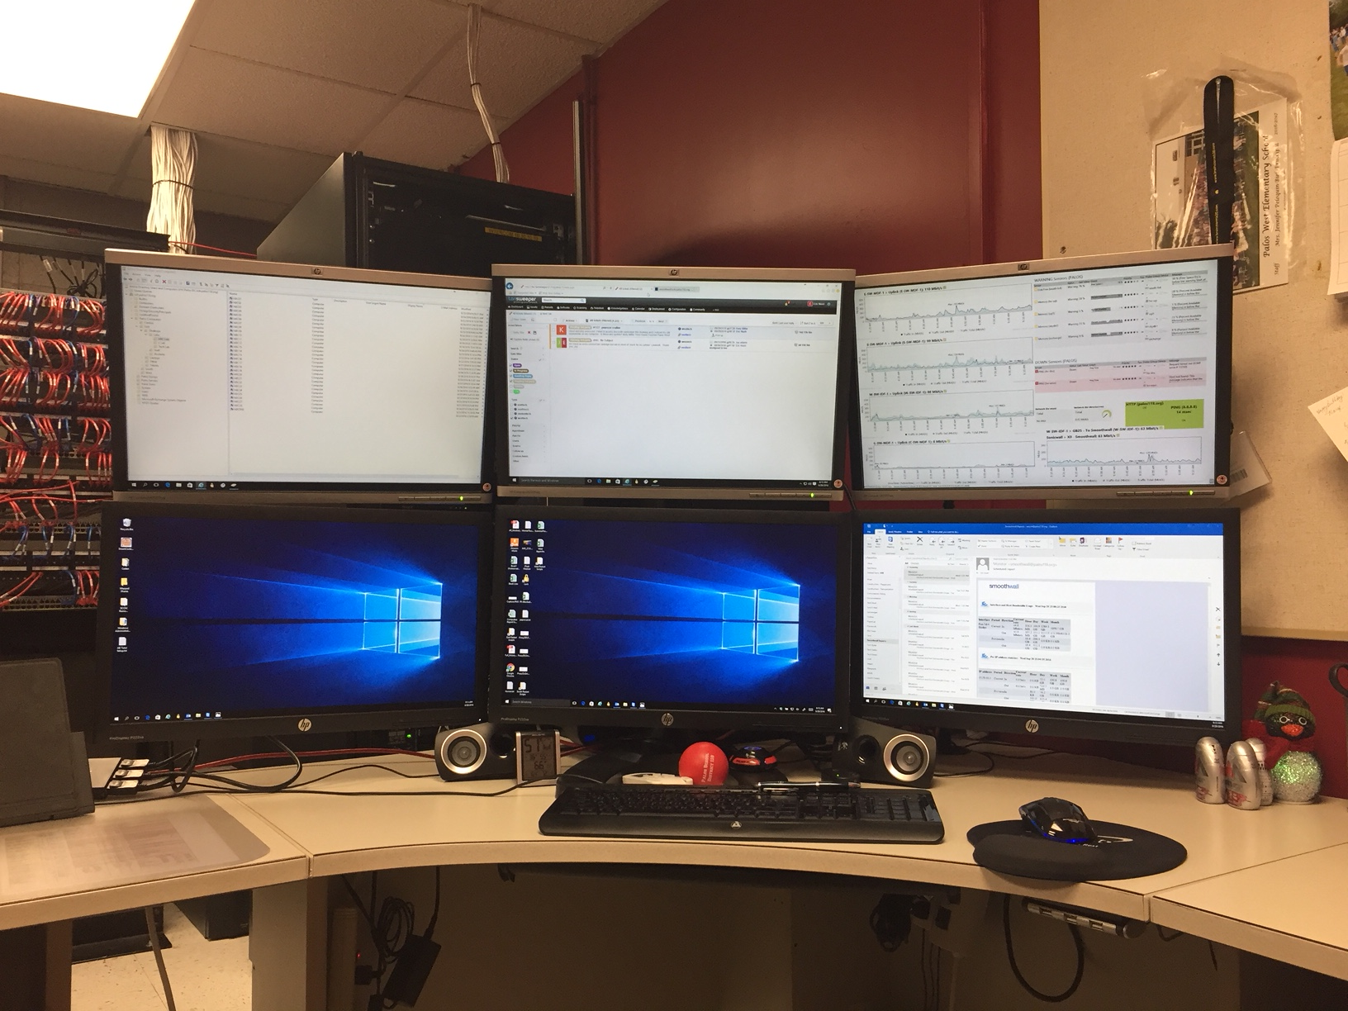
Synergy
Share mouse/keyboard across computers
No KVM required
Copy/Paste Between Computers
$20

Slide 7
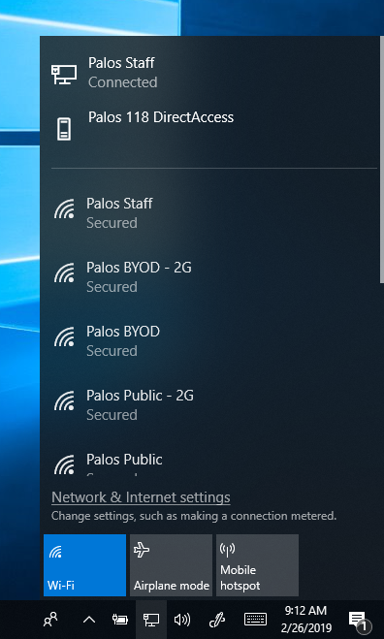
DirectAccess
VPN Client built into Windows 10 Enterprise
Seamless, no user interaction
Detects if computer is inside vs outside network
Connects to all shares/files automatically
Allows our students/staff easy way to access
our local shares

Slide 8
WDS / MDT
Windows Deployment Services
Microsoft Deployment Toolkit
Can reimage any computer over our network
“Agentless”
PXE Boot, Step Through Options, Walk Away
Installs Programs, Updates, Custom Scripts
Different Packages for Teachers/Students
Online tutorials to follow for setup
New computer to “Ready” in 30 minutes

Slide 9
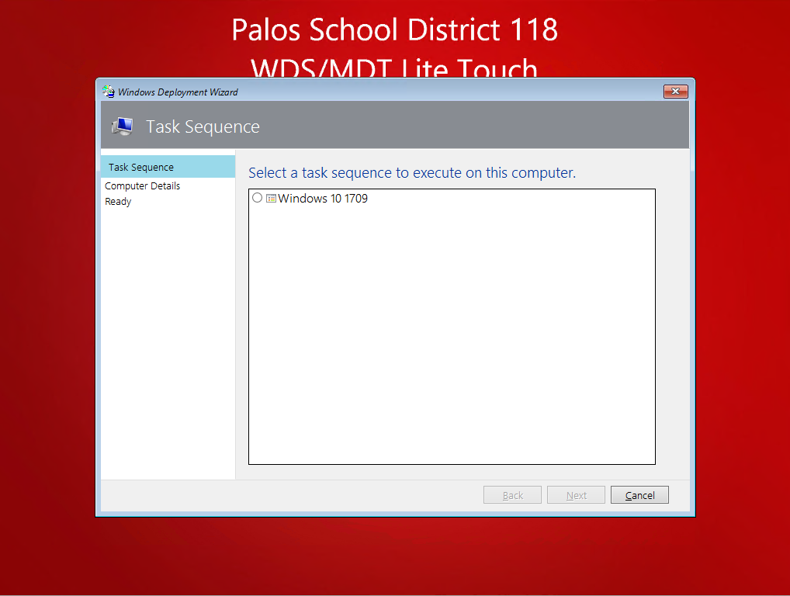

Slide 10
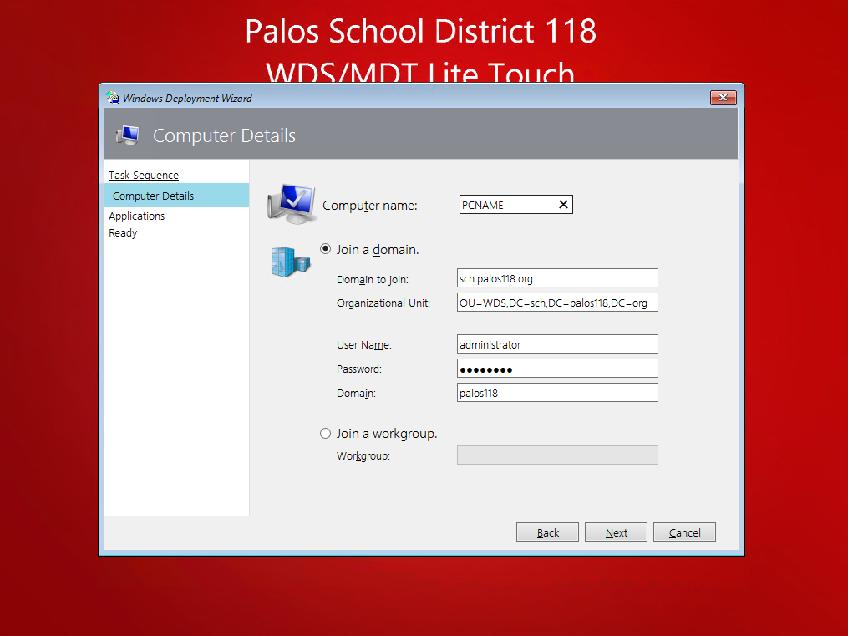

Slide 11
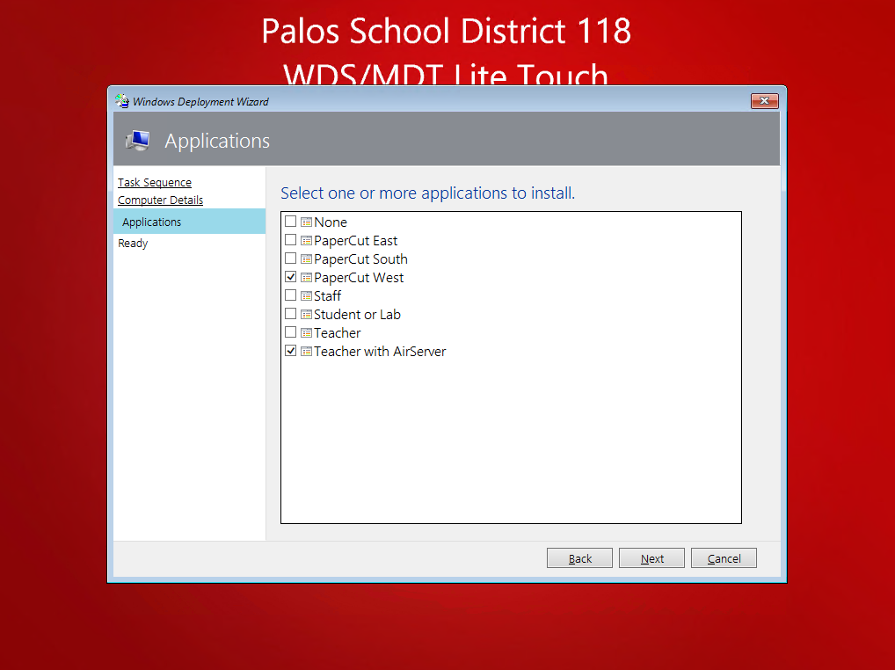

Slide 12
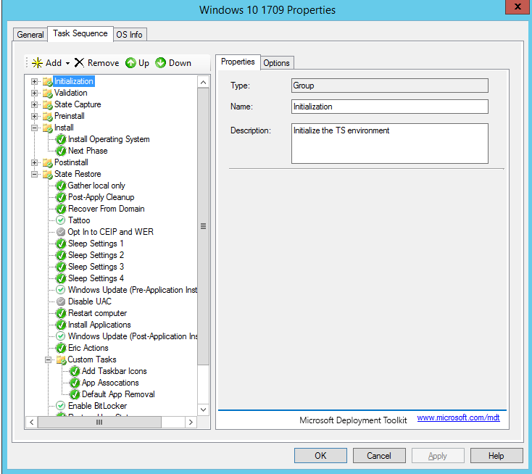

Slide 13
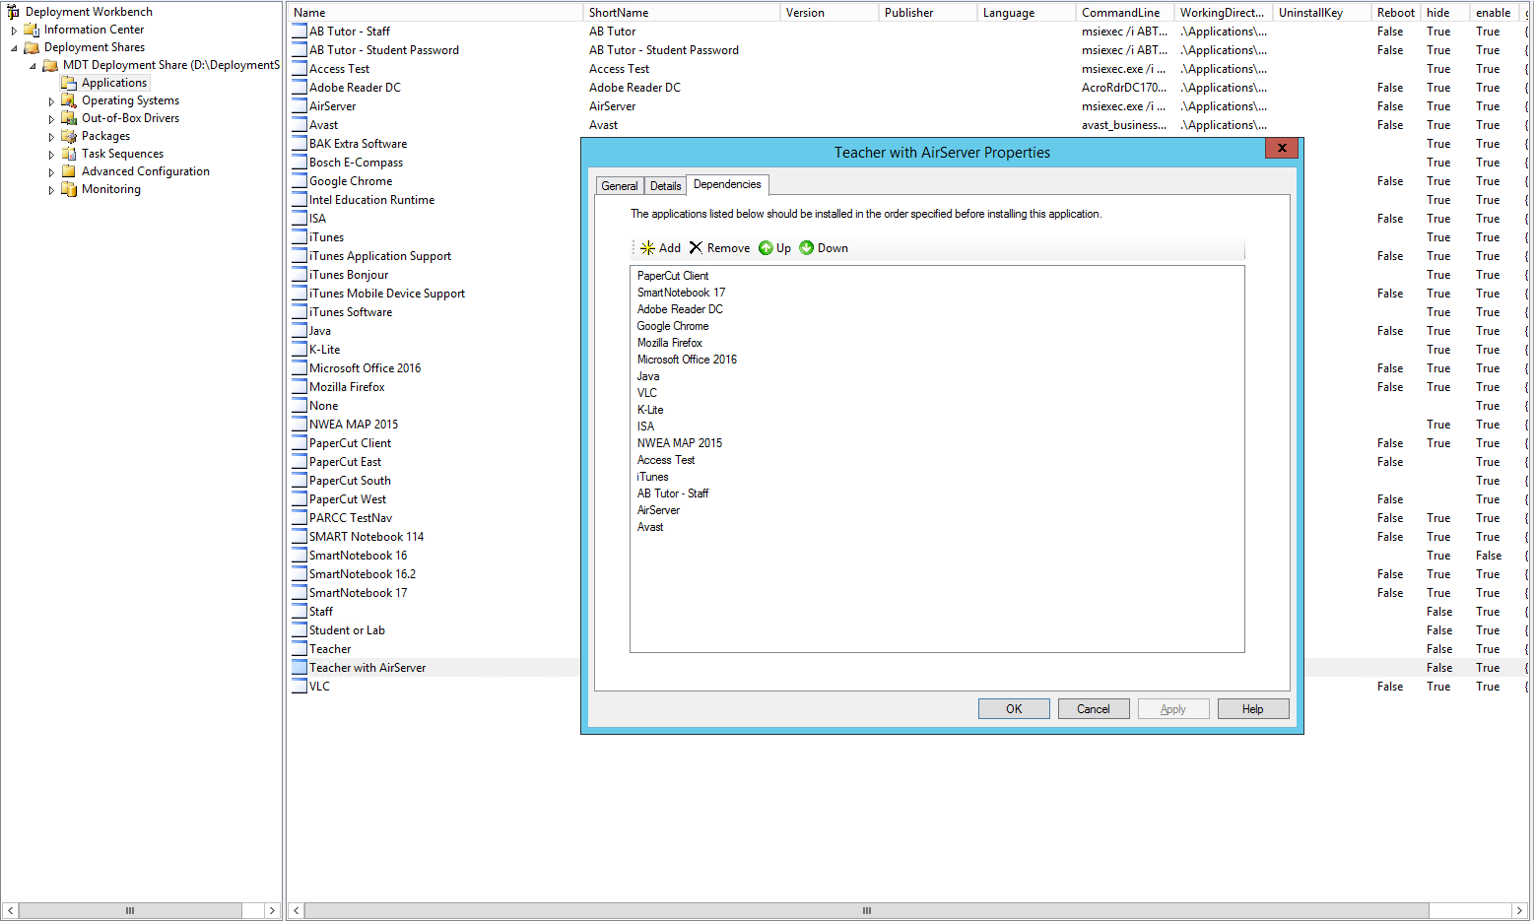

Slide 14
ClassLink
Single Sign On, injects username/password automatically
Works with majority of online accounts, will customize needs
We use it K-8, our youngest students memorize their Student ID and password
Cuts down on time to log into programs
Access Files from home
Demo’d five different companies. ClassLink clear leader, and least expensive!
Amplify ELA, Apple VPP, Biblionasium, BrainPOP, Britannica, Cisco Meraki, CodeStudio, Dynamath, EasyIEP, EBSCO, edHelper, Edpuzzle, enVisionMath, Epic, First Search, Follett, Front Row, Frontline (Aesop), GCN, InTouch, iReady, IXL, Khan Academy, McGraw-Hill ConnectEd, Microsoft Volume Licensing, myLexia, National Geographic, NewsELA, NWEA MAP, Office365, OneDrive, PebbleGo, Pitsco, Planbook, Raptor, Read to Know, Reading A-Z, ReflexMath, Scholastic, Schoology, Seesaw, Skyward, STEMscopes, Storyworks, StudySync, TCi, TumbleBooks, Typing Pal, United Stremaing, WeVideo, XtraMath

Slide 15
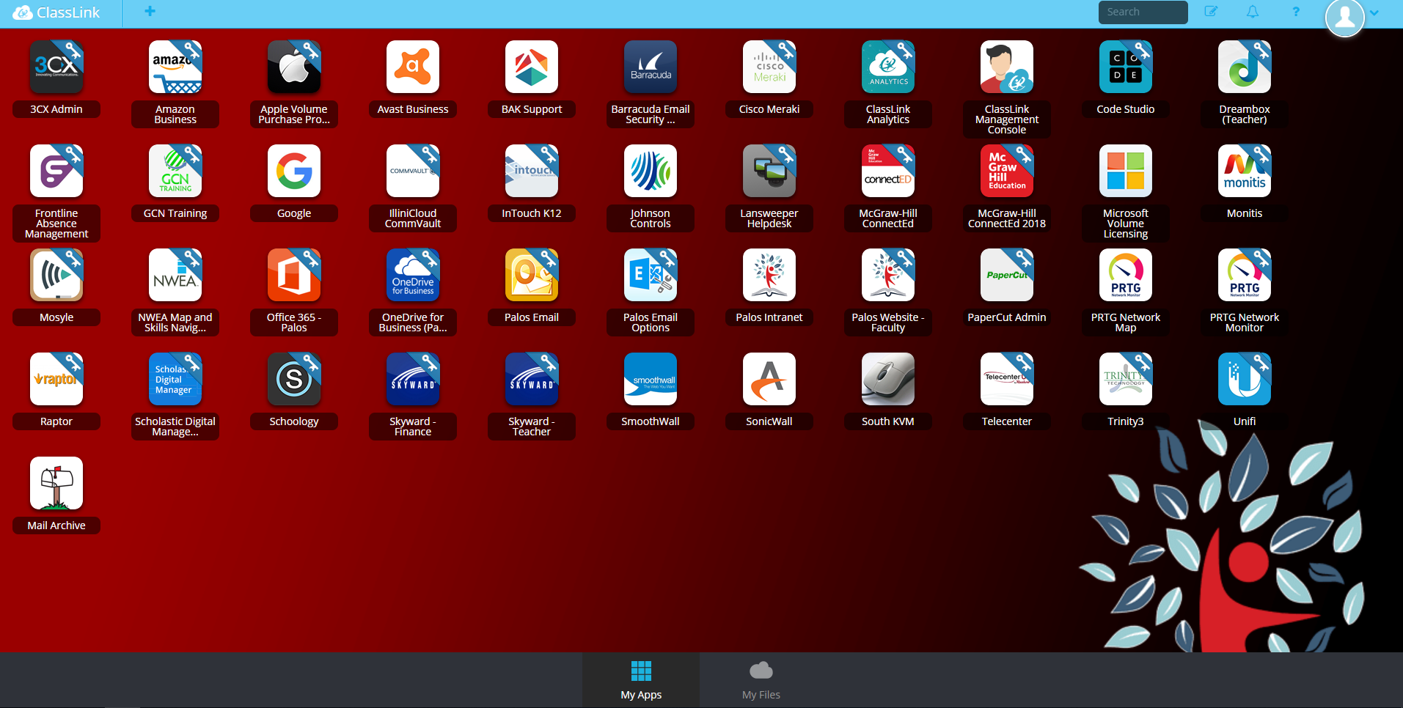

Slide 16
AB Tutor
Screen Monitoring/Control
Great for Techs!
Easy to use
Customize XML files for teachers, only see their class
Password Protected
Site License, One-Time Cost $3,600
Other Big Name Solutions wanted $5/device/year
(3,000 devices is $15k/year)
Not perfect, but great for the price

Slide 17
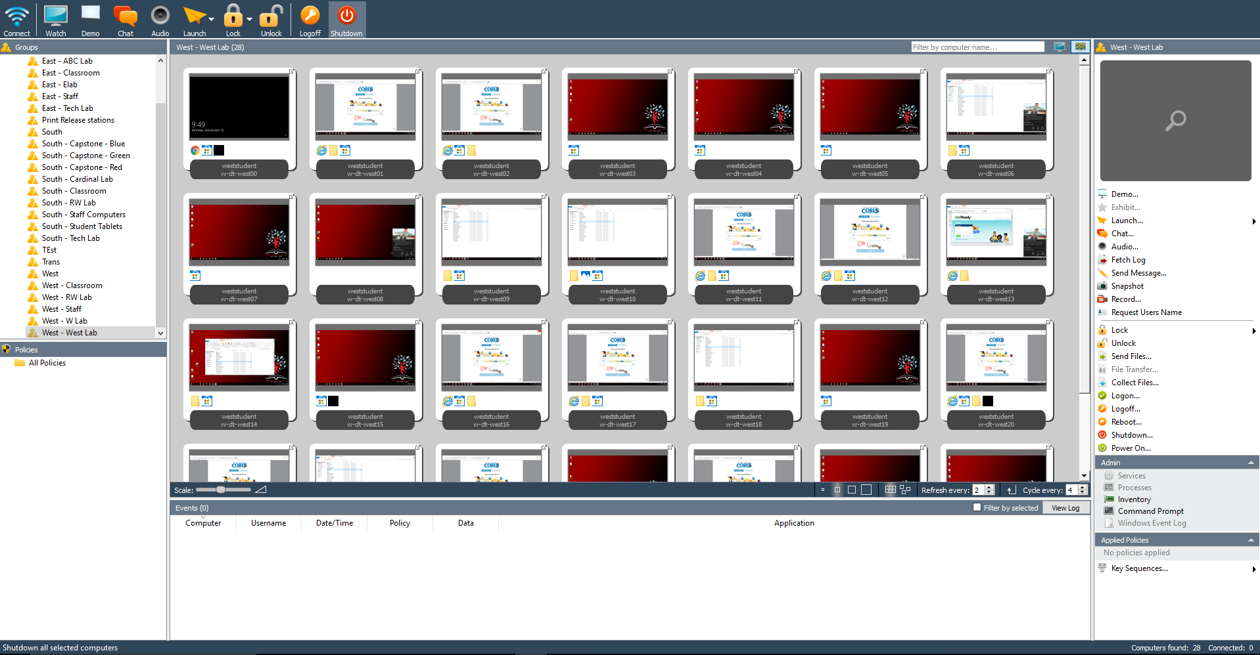

Slide 18
UniFi APs
Replaced Meru with UniFi in Winter 2013
Started with original UniFi AP (green circle) in hallways
Added one per classroom Summer 2014, UniFi AP Pro (blue circle)
Adding/updating with Unifi AC Pro
Almost 350 APs, 1,500 clients daily, over 1.5 Tbs of data over wireless daily
Enterprise Grade Equipment (VLANS, RADIUS, etc)
Low Cost, easy to manage
5 pack without PoE Injectors is $600 on Amazon ($120 each)
Compare to Meraki MR42 - $1,100 each (plus annual license)
Tips: Disable 2.4Ghz radios unless needed
Tips: Set 5Ghz radios to Medium Power
Tips: Can script a nightly reboot with CMD, Putty, SSH

Slide 19
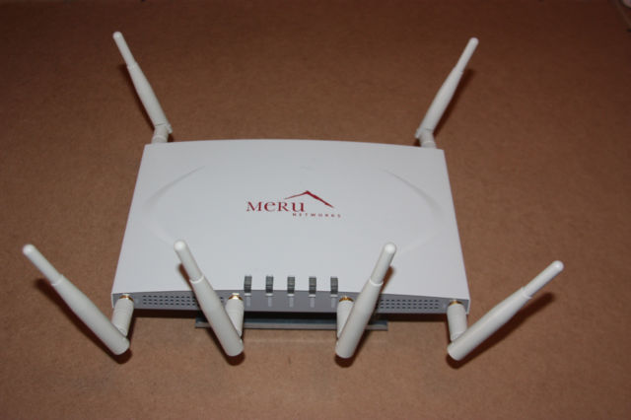
Old Meru AP

Slide 20
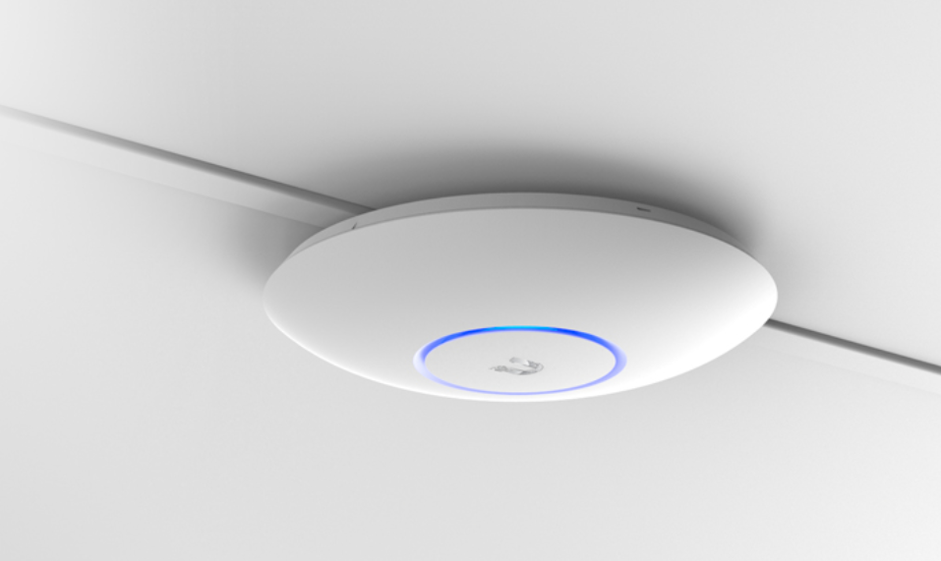
UniFi AP AC PRO

Slide 21
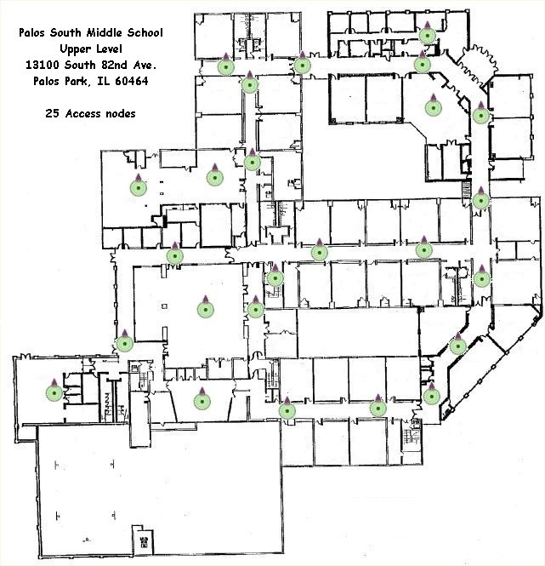
Old
Meru AP
Layout

Slide 22
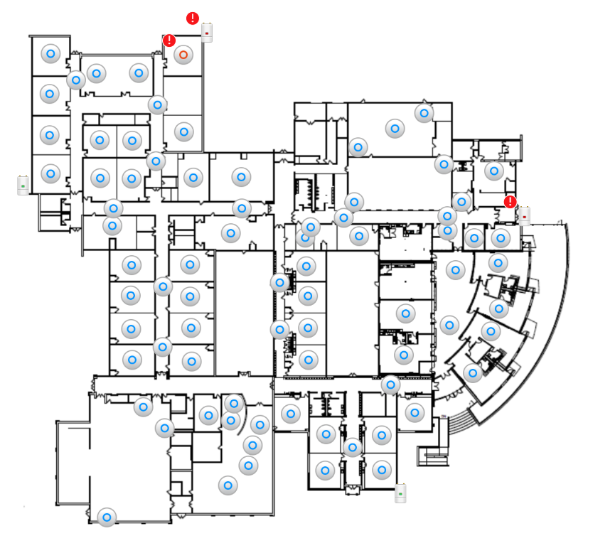
UniFi AP
Layout

Slide 23
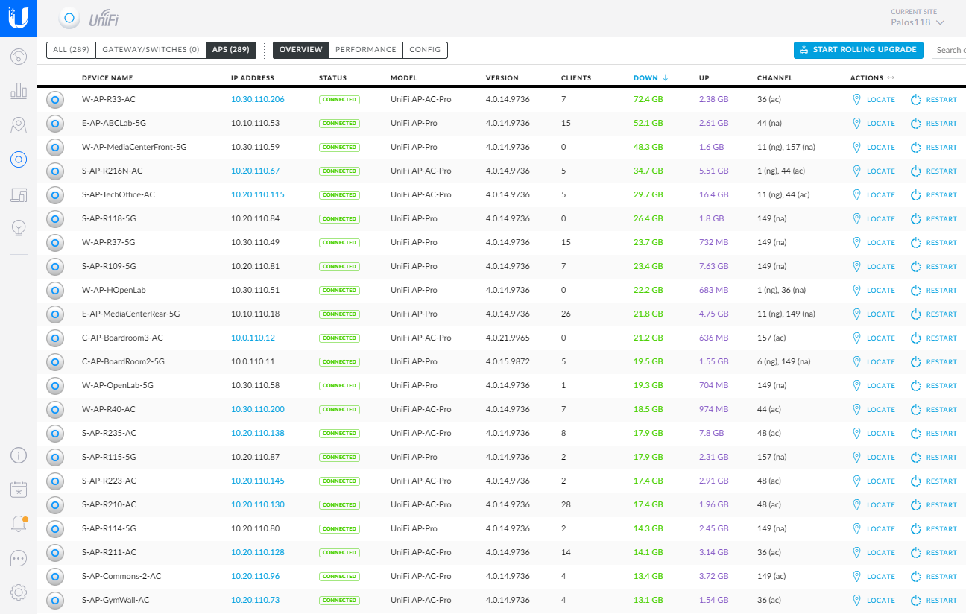

Slide 24
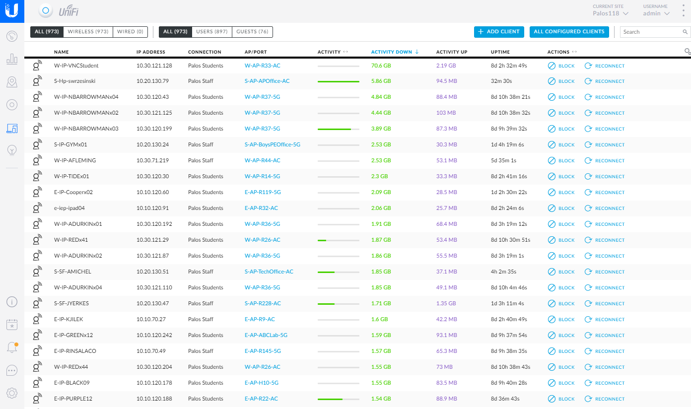

Slide 25
Netgear SmartSwitch
Replaced Cisco/Juniper with Netgear
One time cost
No service contracts/license
Lifetime warranty on Business Class
48 port Layer 2 Smart PoE Switch - $499
Compare to Meraki MS120-48LP - $3,925
VLAN Routing, QoS, all the necessities

Slide 26
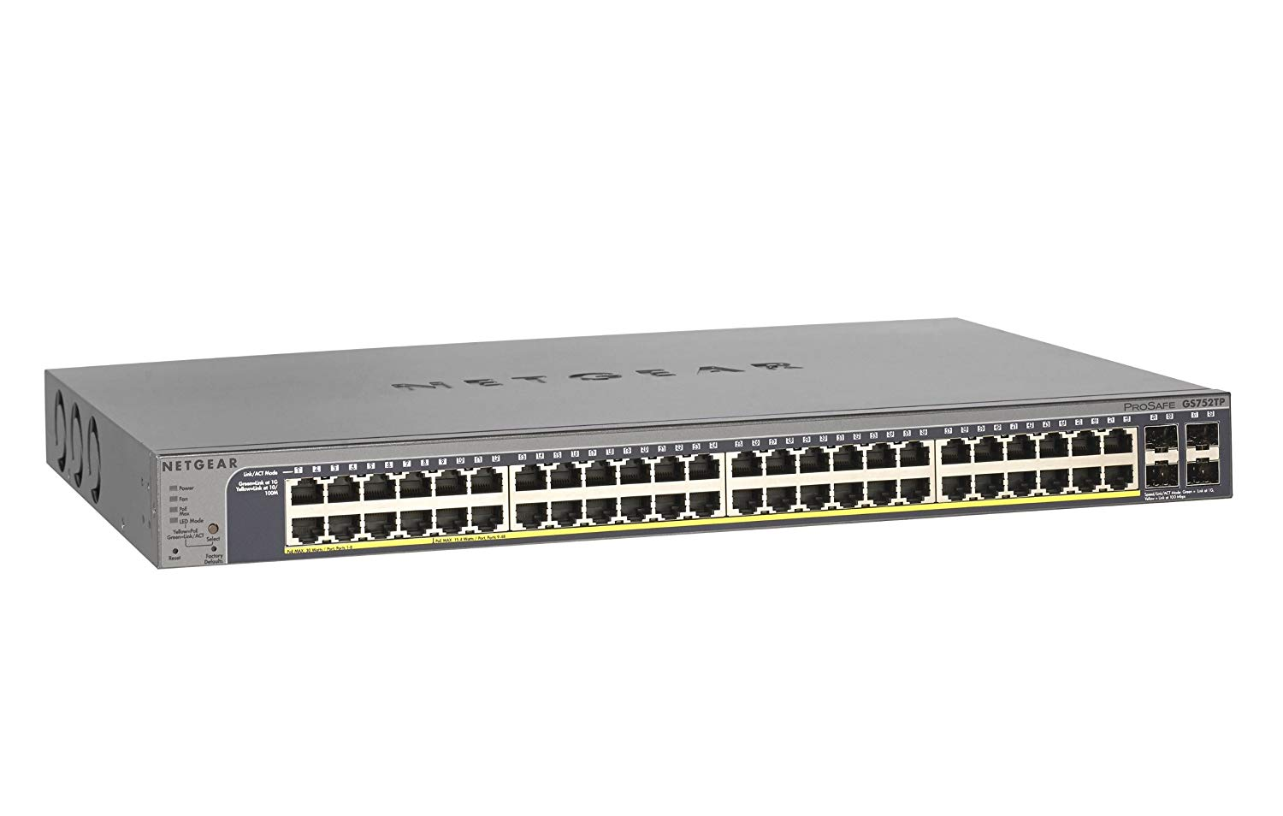

Slide 27
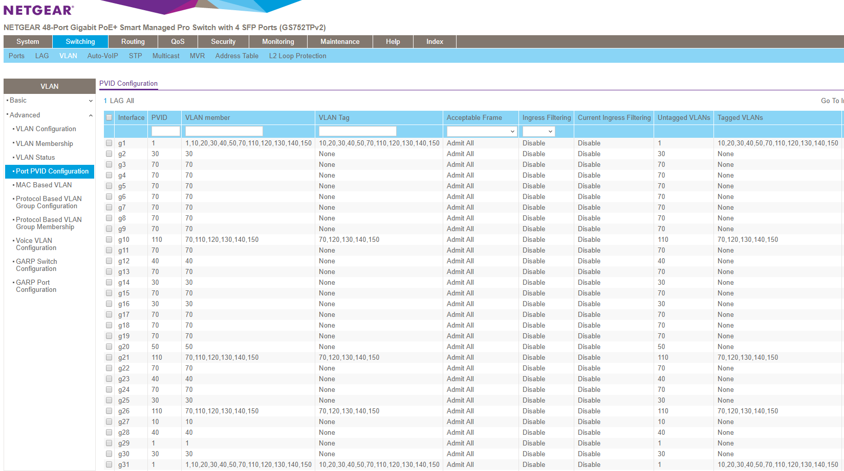

Slide 28
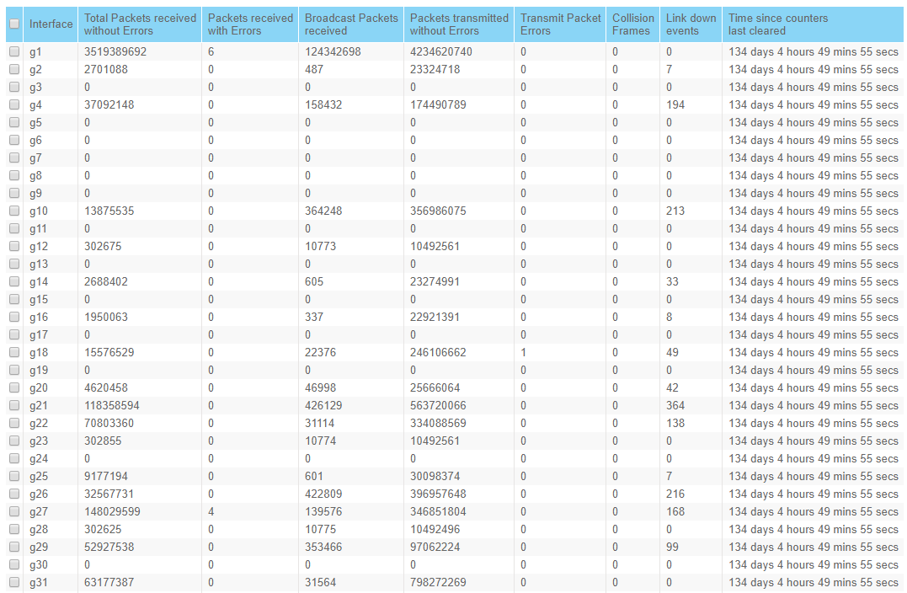

Slide 29
VoIP
Our district replaced 3COM/Vertical system with 3CX and Yealink Phones
Eliminated all POTS (security, fax, elevators, Nicor, etc)
Eliminated two PRI Lines
SIP Trunk, routes phone calls over Internet Connection
Make sure you have enough bandwidth, traffic shaping
Changes took our annual costs from $40k+ to under $9k
The savings paid for new system
On-Site system is cheaper than cloud based
10 year Total Cost of Ownership: Previous - $350k, Cloud - $750k, 3CX - $150k
Compared Rival5, Mitel, CallOne, Digium, ShoreTel, Asterisk

Slide 30
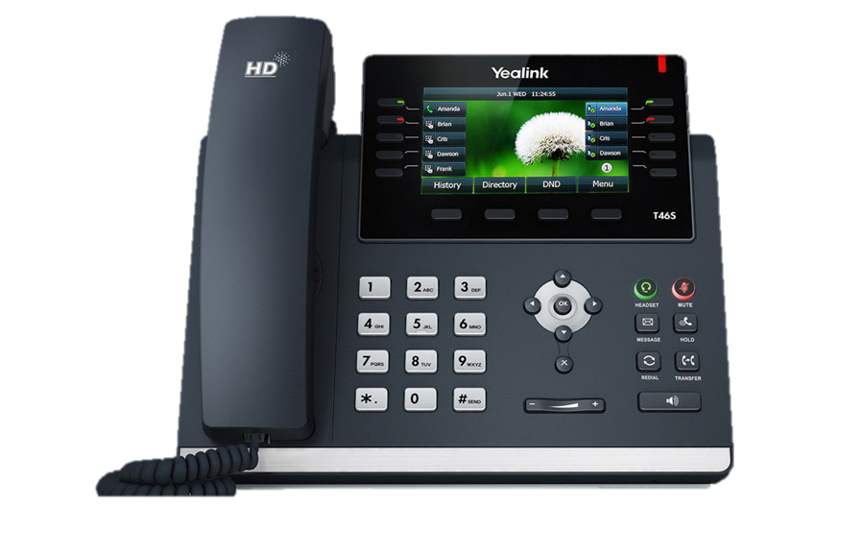
$150
All classrooms

Slide 31
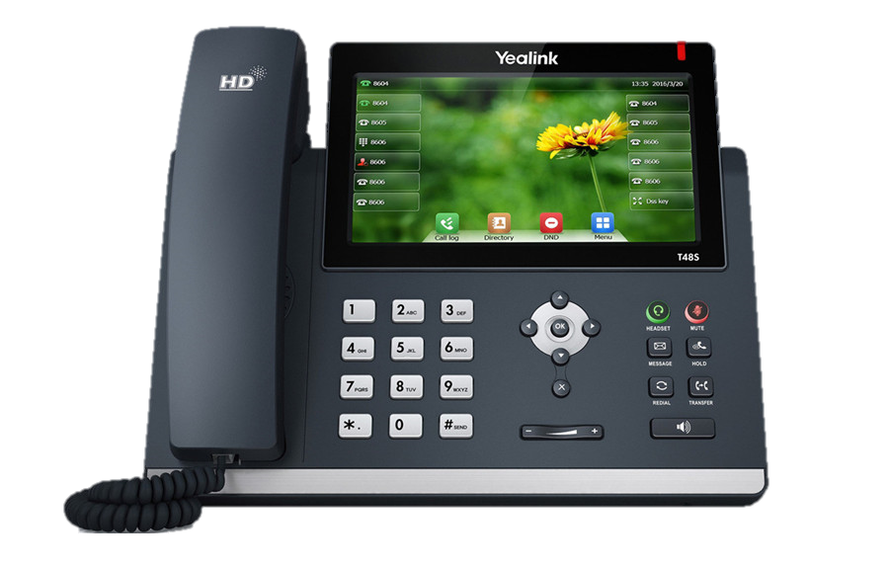
$190
All Office,
Admin, &
Technology

Slide 32
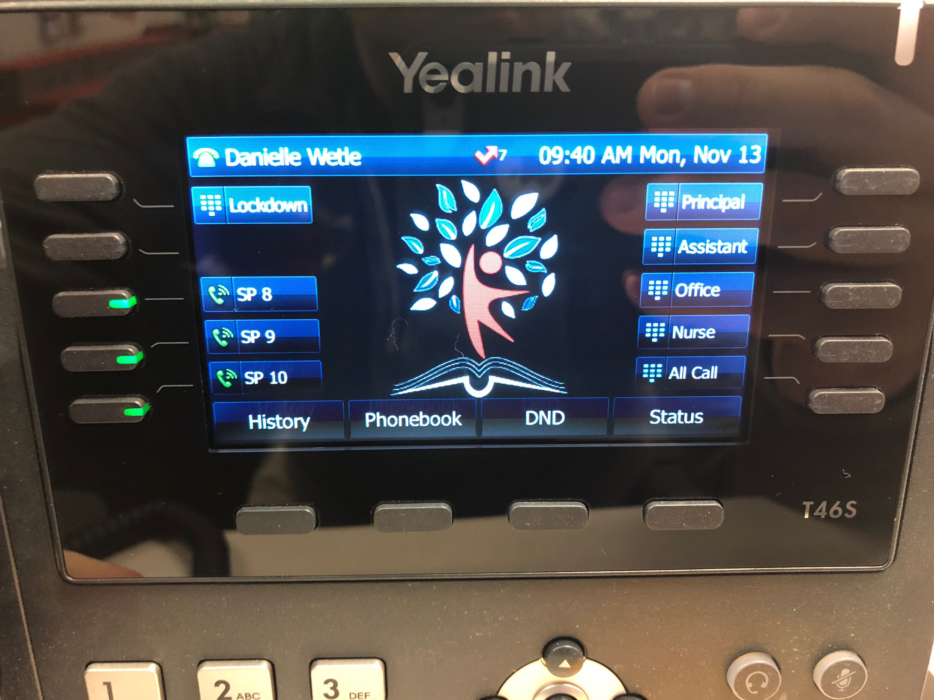

Slide 33
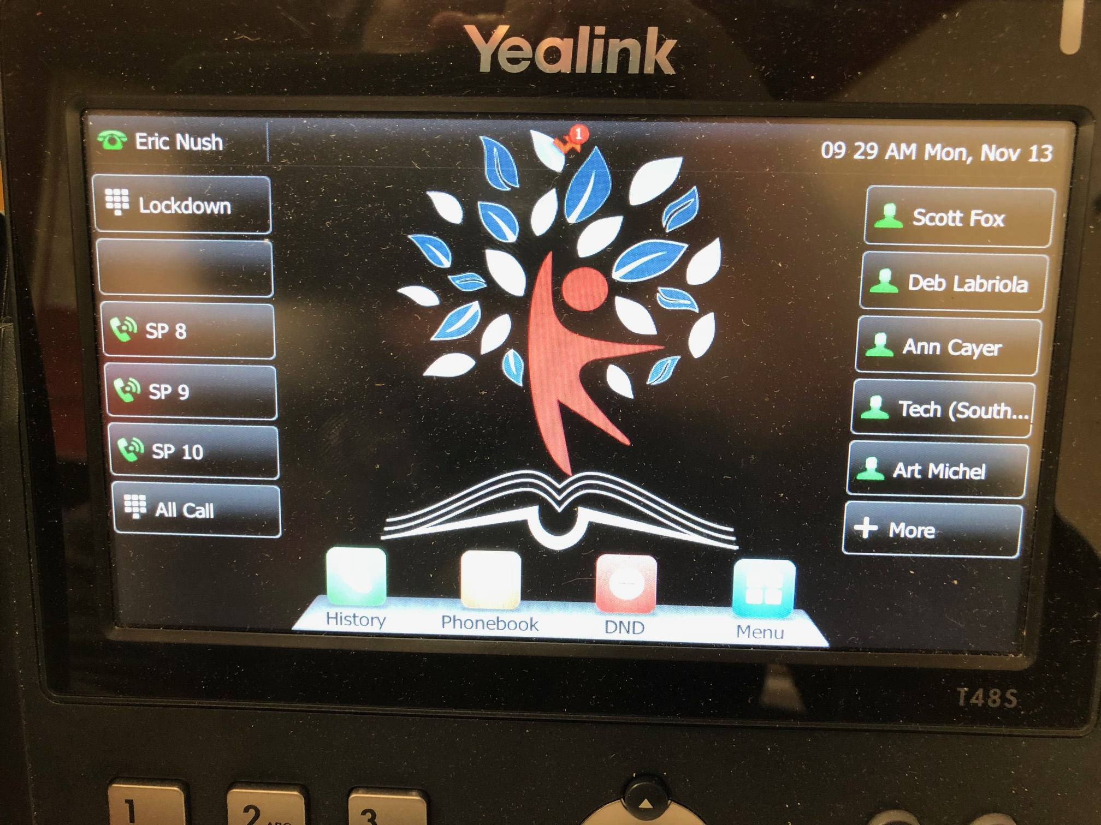

Slide 34
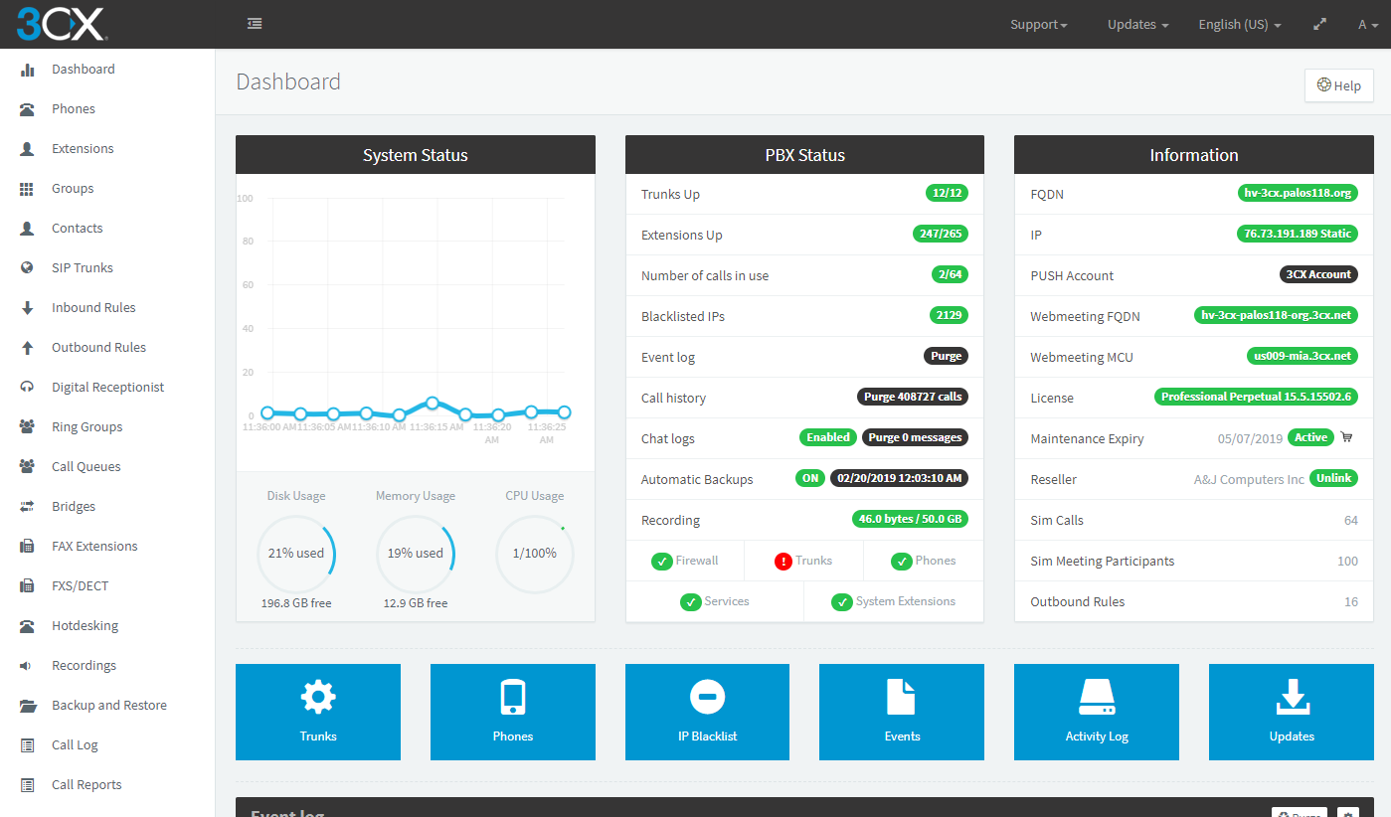

Slide 35
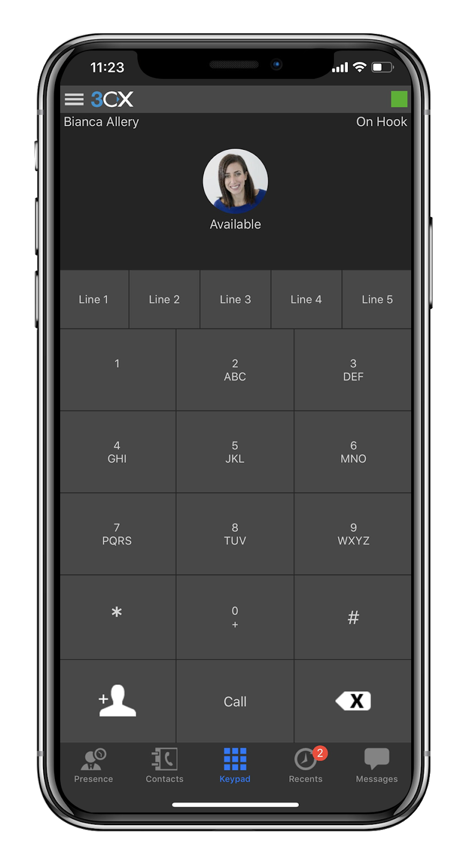
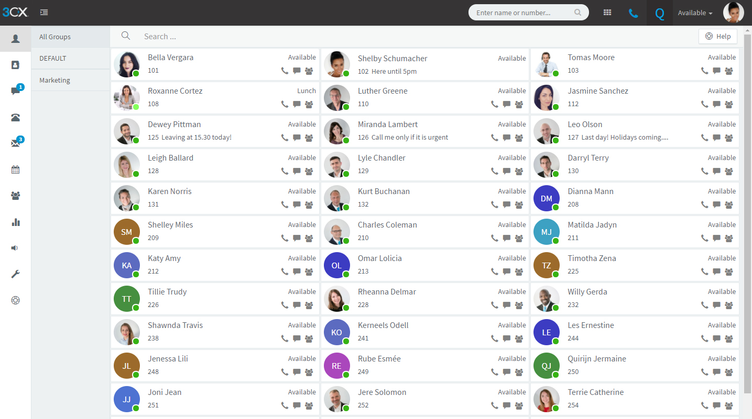

Slide 36
eFax
Replaced 10 POTS Fax lines with 6 eFax accounts
Annual costs went from $15k to $1,500
eFax Ports Numbers
Each account has 5 Emails to Send, 5 Emails to Receive
Complete Digital Trail, Secure, Compliant with HIPPA, PCI, GLBA, SOX
Incoming faxes go to common mailbox “WestFax@palos118.org”
Building secretaries monitor this inbox in Outlook
They forward or print faxes as needed, similar to taking fax off machine
Building secretaries and nurse are allowed to send
Write email to number@efaxsend.com “17087613809@efaxsend.com”
Copiers use same email account, so they can scan to fax also.

Slide 37
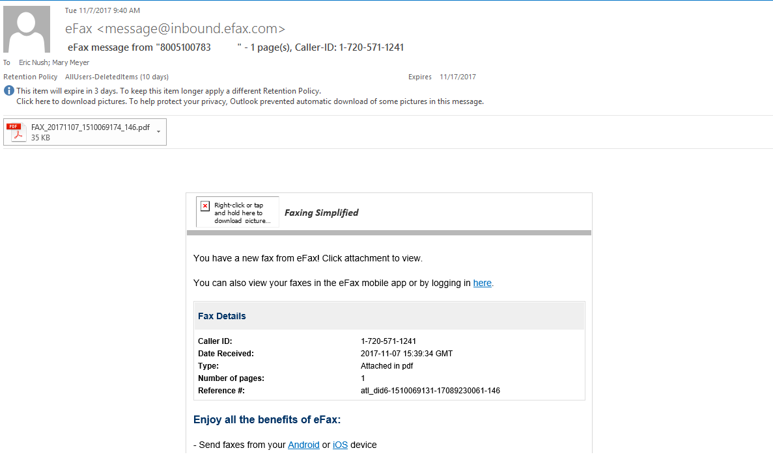

Slide 38


Slide 39
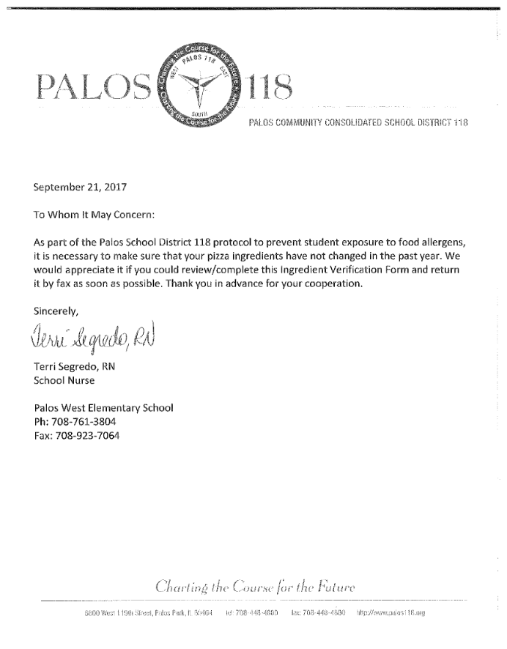

Slide 40
PaperCut
Print Manager, logs/tracks all prints
Free version, just logs network print jobs. No actions.
NG – no copier integration, MF – copier integration
Print Release Station – doesn’t print until you walk up to printer
Follow Me - print to virtual print queue, release anywhere
Removing printers, moving towards color copier only
Keeps files secure (Report Cards, IEPs, etc)
Can embed with copiers to track copies (MF only)
Can use card readers or fobs to authenticate

Slide 41
PaperCut
Cost per page BW classroom laser printer: $0.30 (100k, $30k)
Cost per page Color Laser Printer: $0.15 (100k, $15k)
Cost per page Copier - Grayscale: $0.005 (100k, $500)
Cost per page Coper - Color: $0.04 (100k, $4k)
Unreleased jobs total 5k pages a week (saving $18k annually)
Convert to grayscale - approx. 90% convert (saves $3k per 100k pages)
Palos Costs (Roughly 10M pages/year)
Convert to grayscale saves $300k/year
Moving from printers to copiers saved over $1M
Printing costs now under $100k

Slide 42
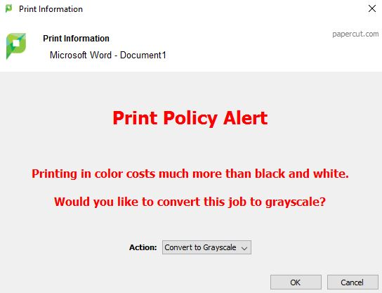

Slide 43
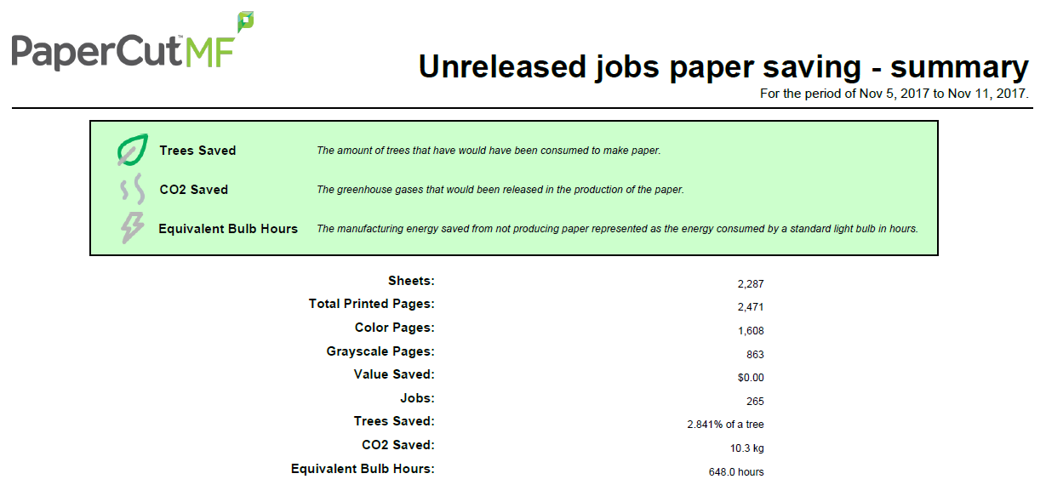

Slide 44
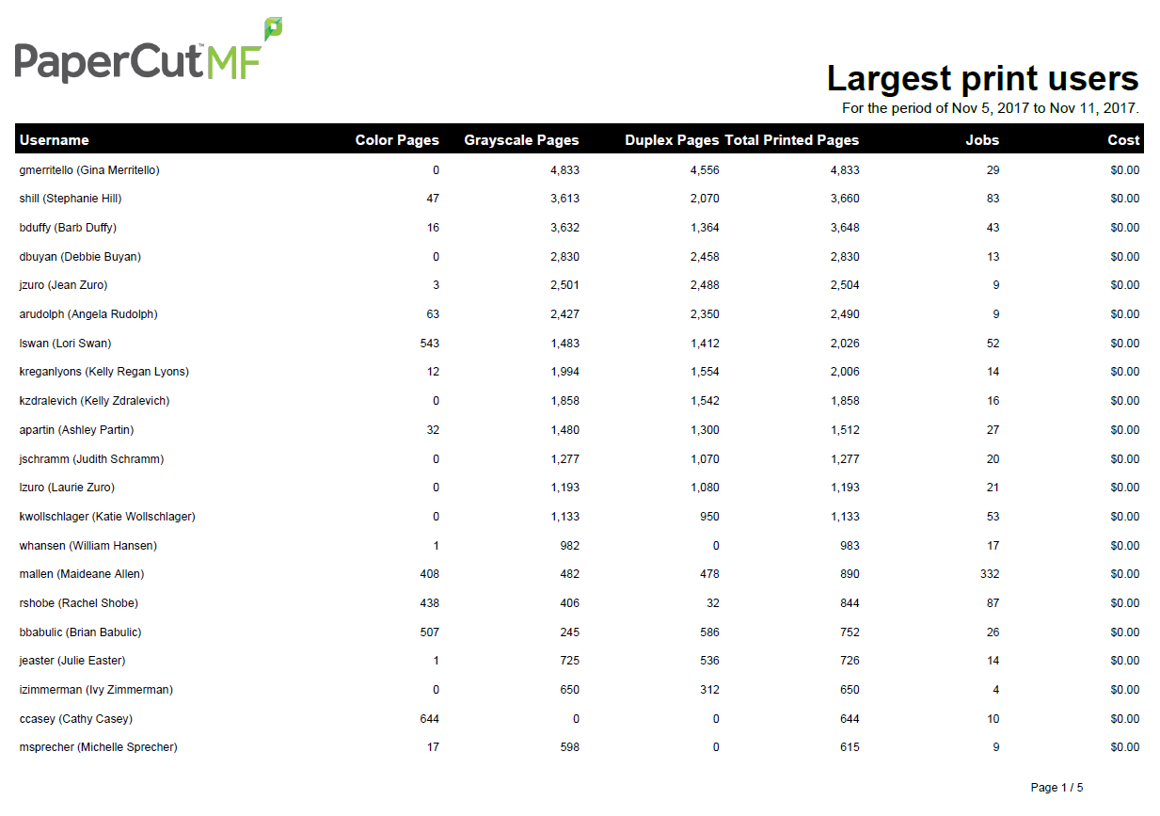

Slide 45
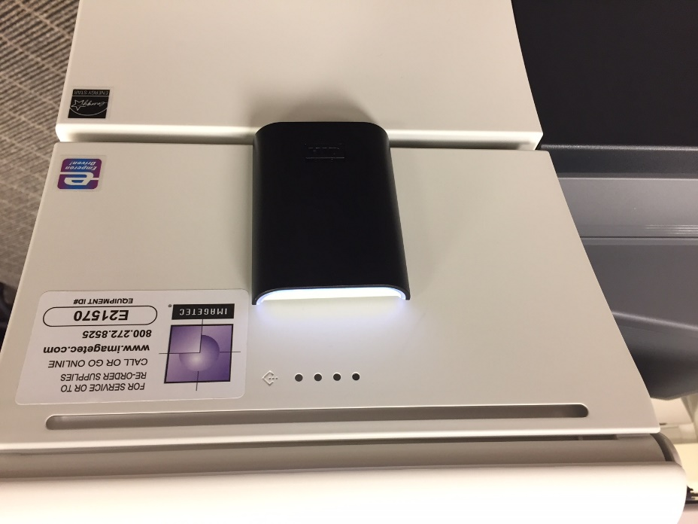

Slide 46
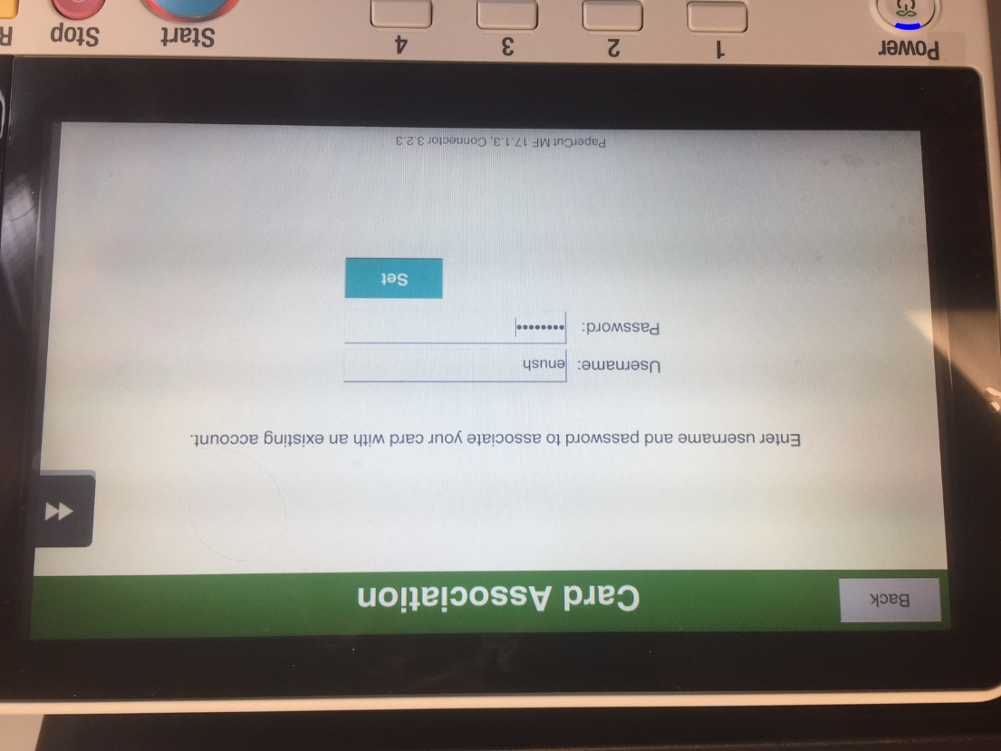

Slide 47
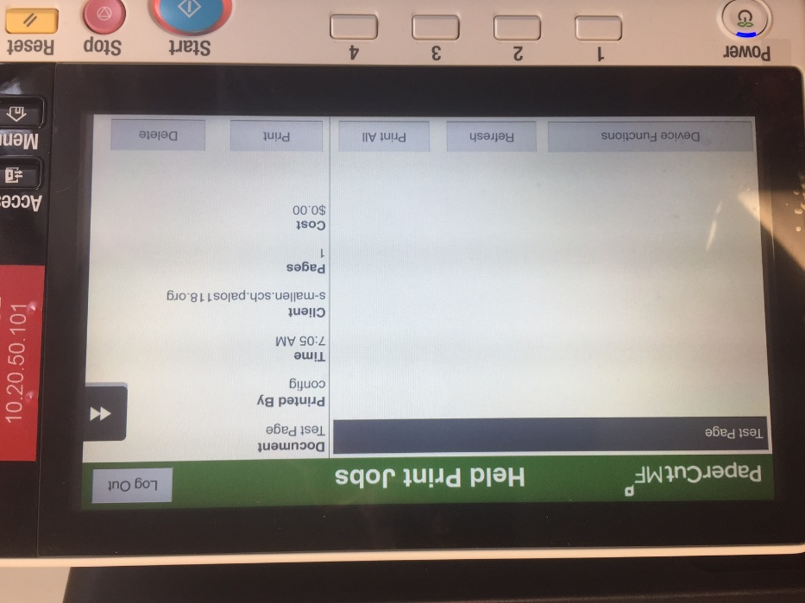

Slide 48
VideoInsight
Affordable and reasonable security camera software
Desktop Software, Webpage, iOS App, Android App
Purchased by Panasonic in 2018
Panasonic Cameras – no license needed
Advidia Cameras – 32 cameras max per server
We split it up, about 20 cameras per server
Advidia 2MP Camera - $327
Advidia 5MP 360-Degree Camera - $540
Advidia 6MP Camera - $940
Total for 20 Cameras and Custom Server - $10k

Slide 49
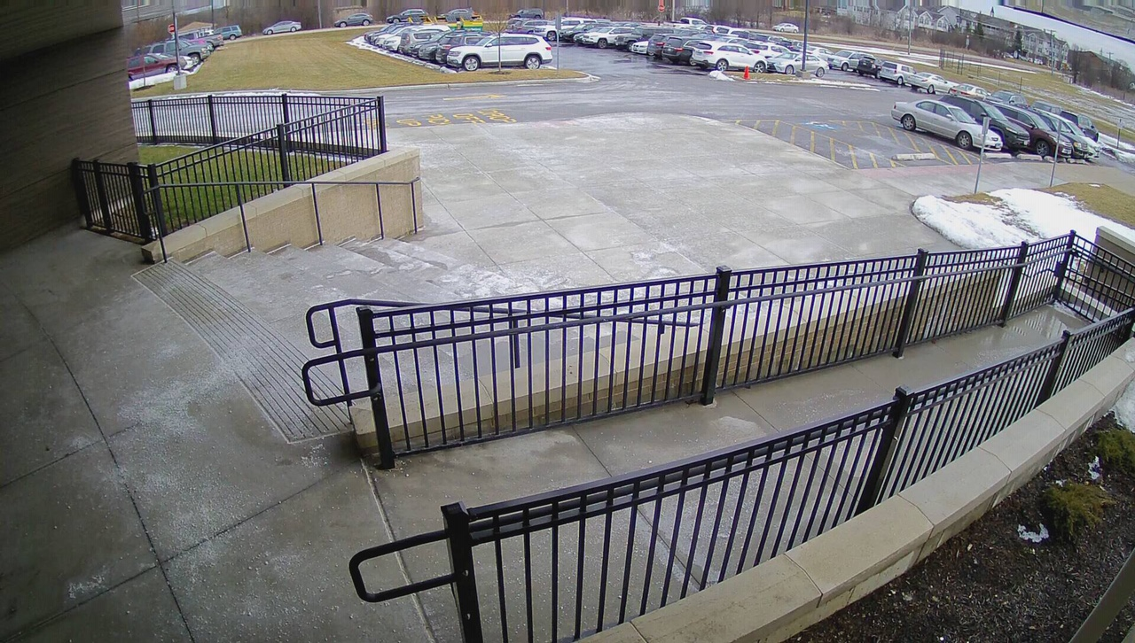
Advidia A-37-FW
2MP - $327

Slide 50
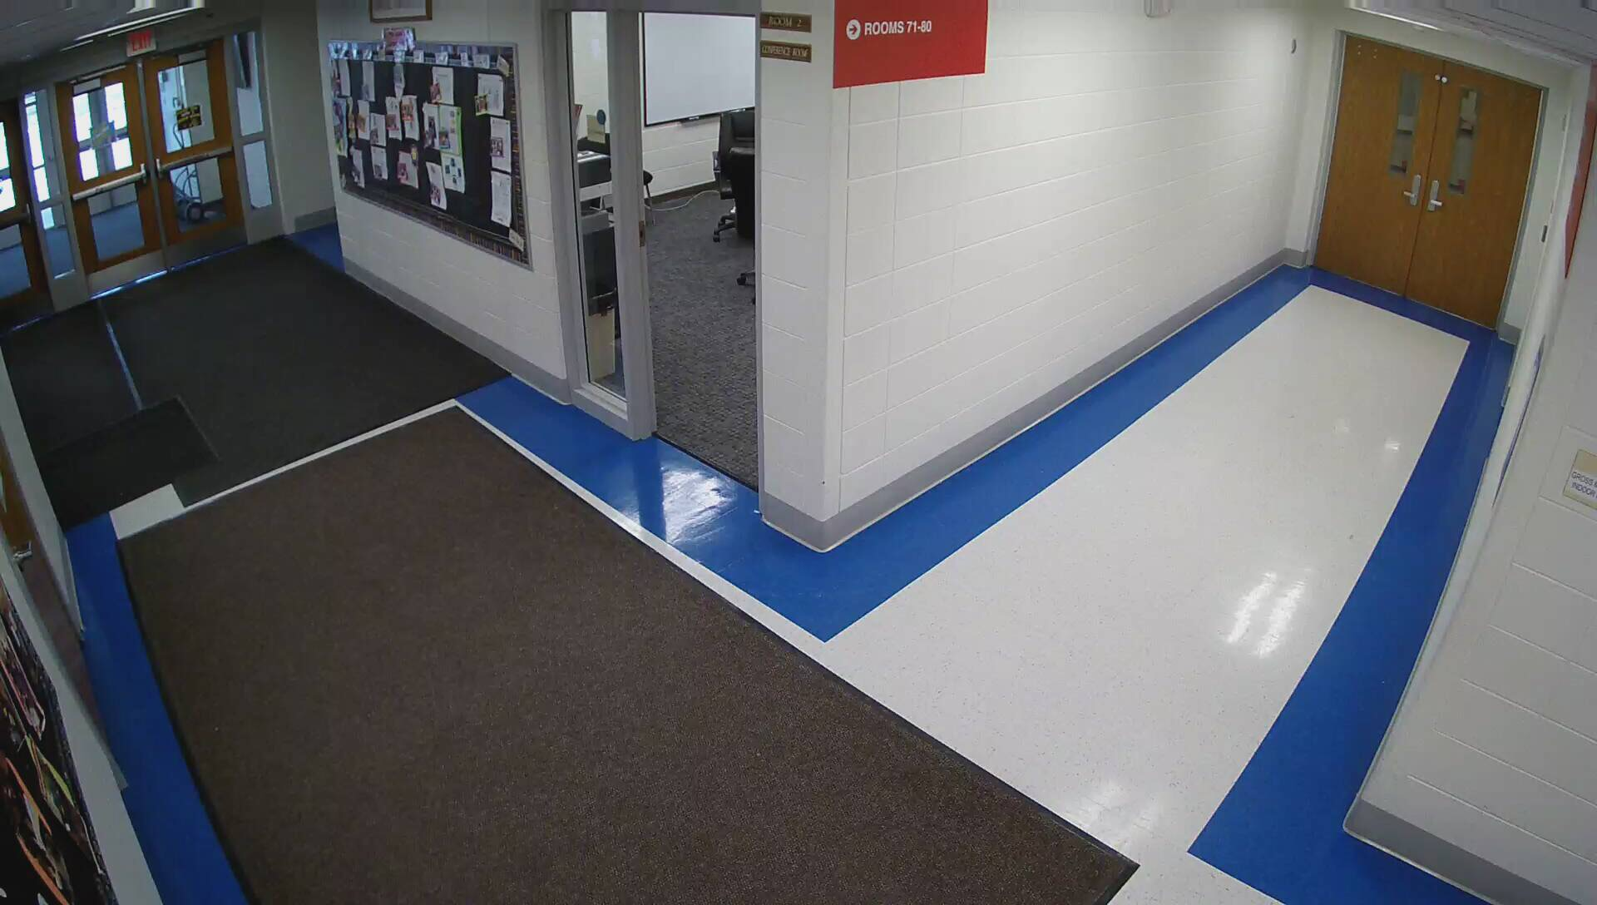
Advidia A-37-FW
2MP - $327

Slide 51
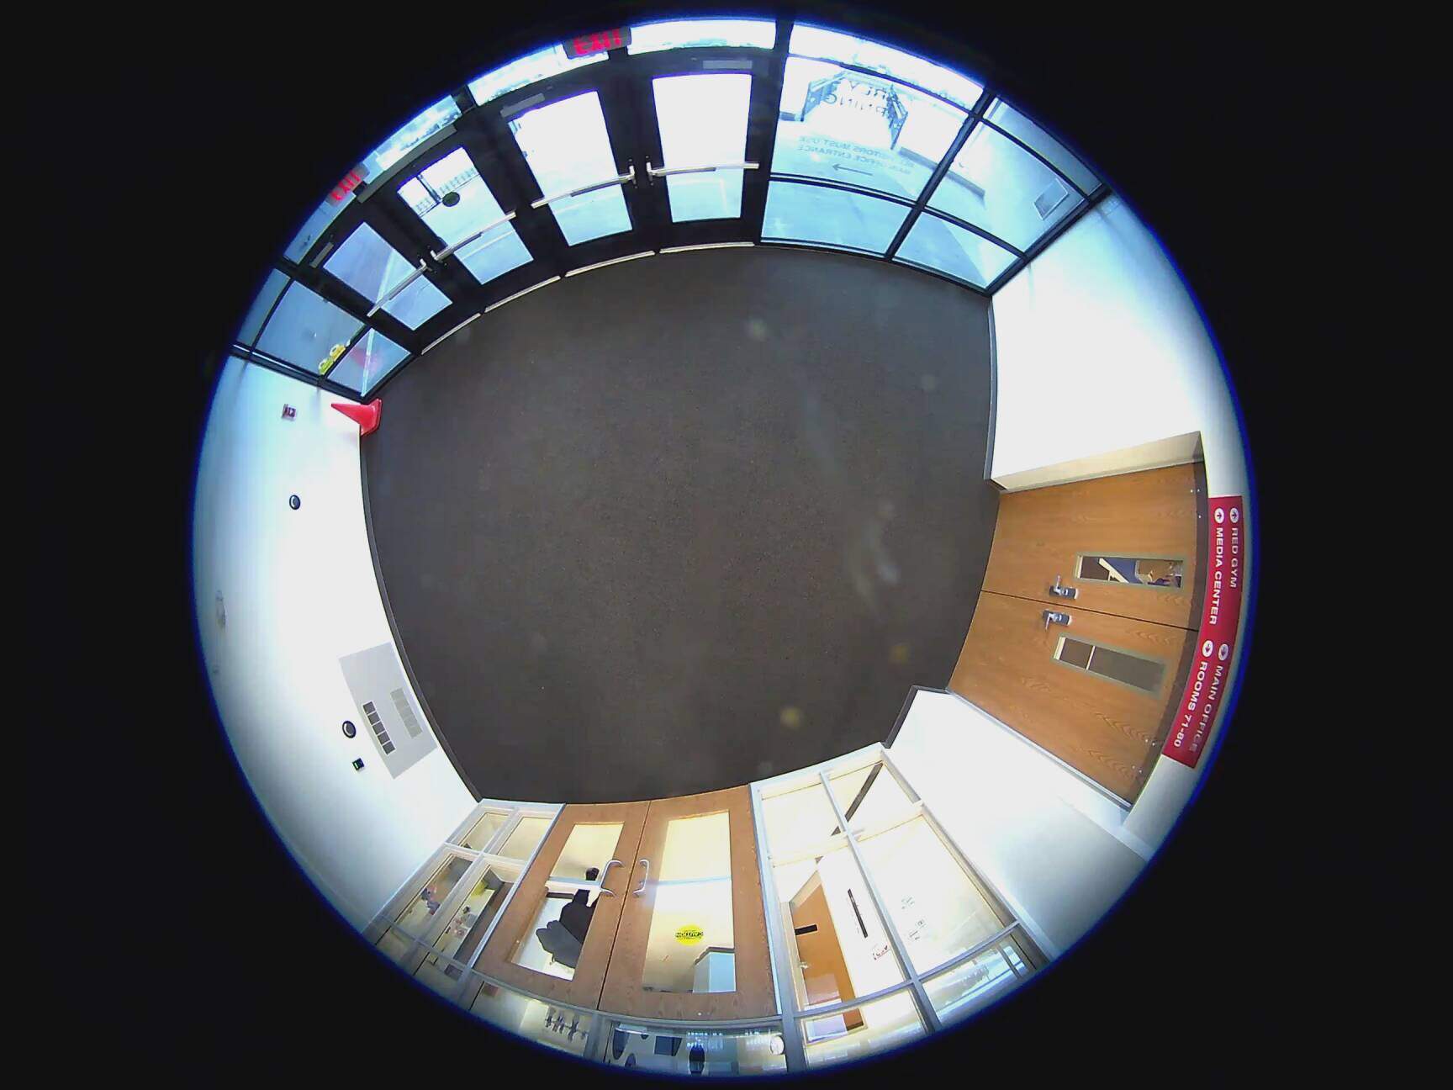
Advidia B-5360
5MP - $540

Slide 52
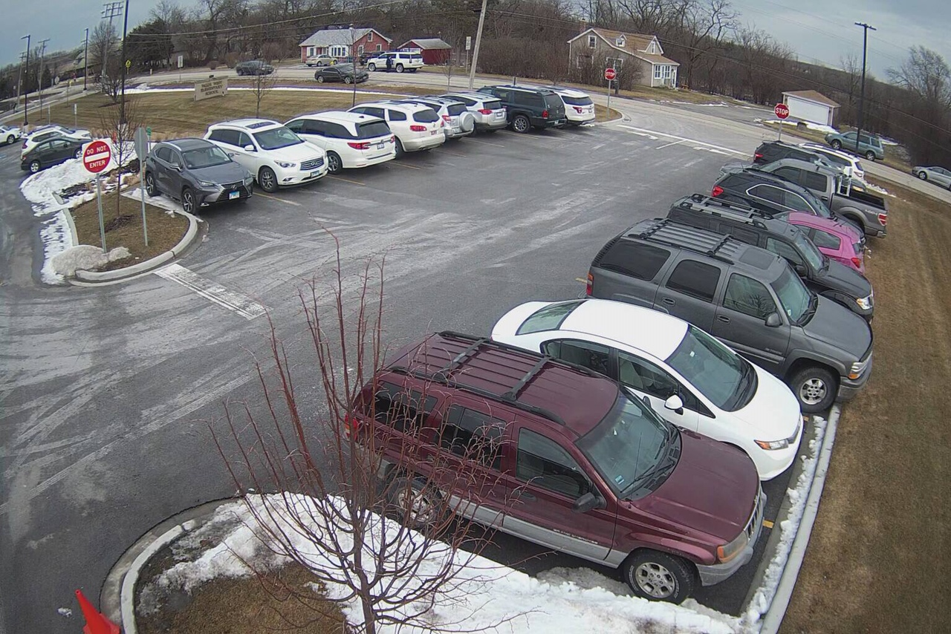
Advidia A-64
6MP - $940

Slide 53
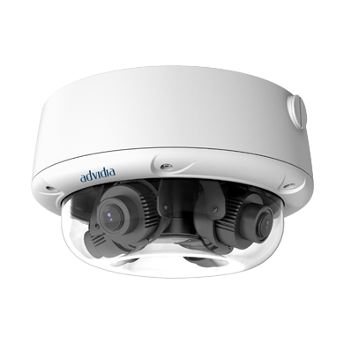
Advidia A-427-V
8MP - $1,400
1 Network Drop
4 x 2MP Cameras
PoE Powered
No IR

Slide 54
Custom Servers
Build your own, saves money!
“Non-Critical” (No Exchange, Sharepoint, Skyward)
Limitation: Not ECC RAM
Limitation: No dual power supplies (but keep extra in office)
Works great for IP Security Cameras
4.2 Ghz i7, 32 GB RAM, 70 TB DATA HD, 250 GB SSD OS DRIVE
70 TB saves 20 Advidia Cameras 24/7 30-days
$3,500
Comparable on Dell: $17,500
Case | Rosewill 4U Server | 240
PSU | EVGA 850w | 120
Motherboard | MSI X229 | 230
CPU | i7-7800X 4.2Ghz | 360
RAM | Kingston 32GB DDR4 | 300
HD-OS | 250GB SSD | 70
HD-DATA | WD Purple 10TB x 7 (70 TB) | 2,212
 | Total | 3,532

Slide 55
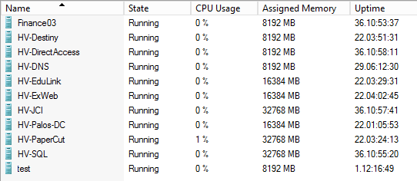
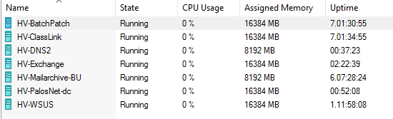
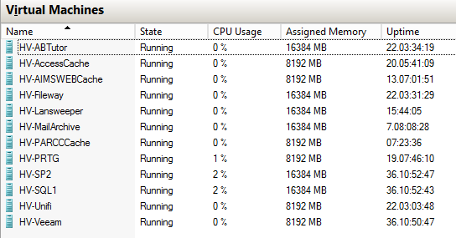
Hyper-V
One “large” server hosting many smaller servers
Saves on hardware costs
Less power, less air-conditioning
Less space!
Clustering/Failover/Replica

Slide 56
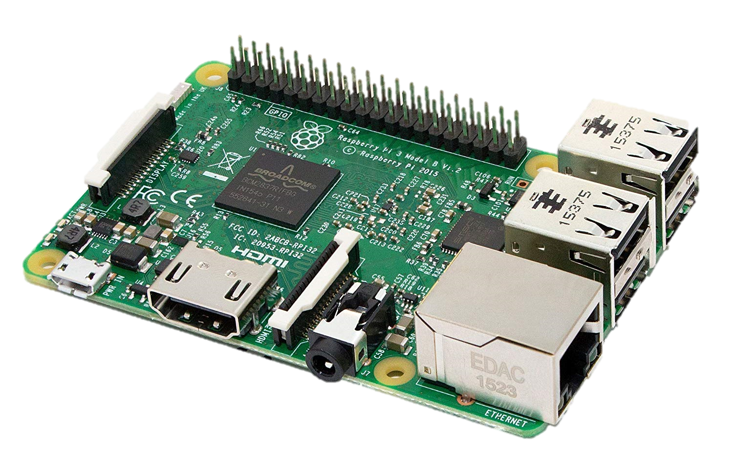
Raspberry Pi
Micro computer
Useful for random needs
PRTG Monitors in Tech Office
Digital Signage
Temperature Monitor
Notifications
Status Monitors
Raspberry Pi 3 Model B - $35
PoE Adapter - $10
16GB MicroSD Card - $5

Slide 57
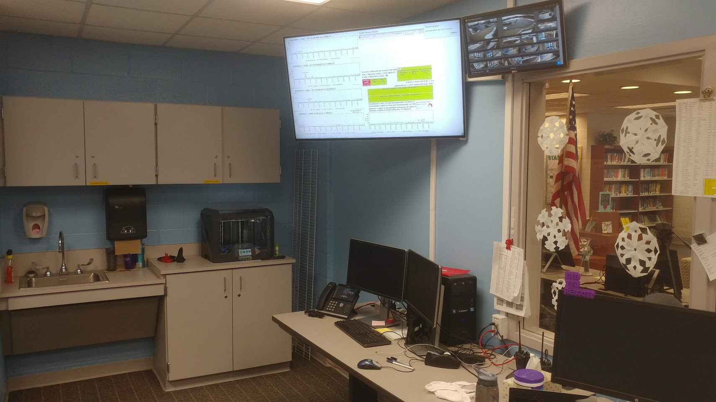

Slide 58
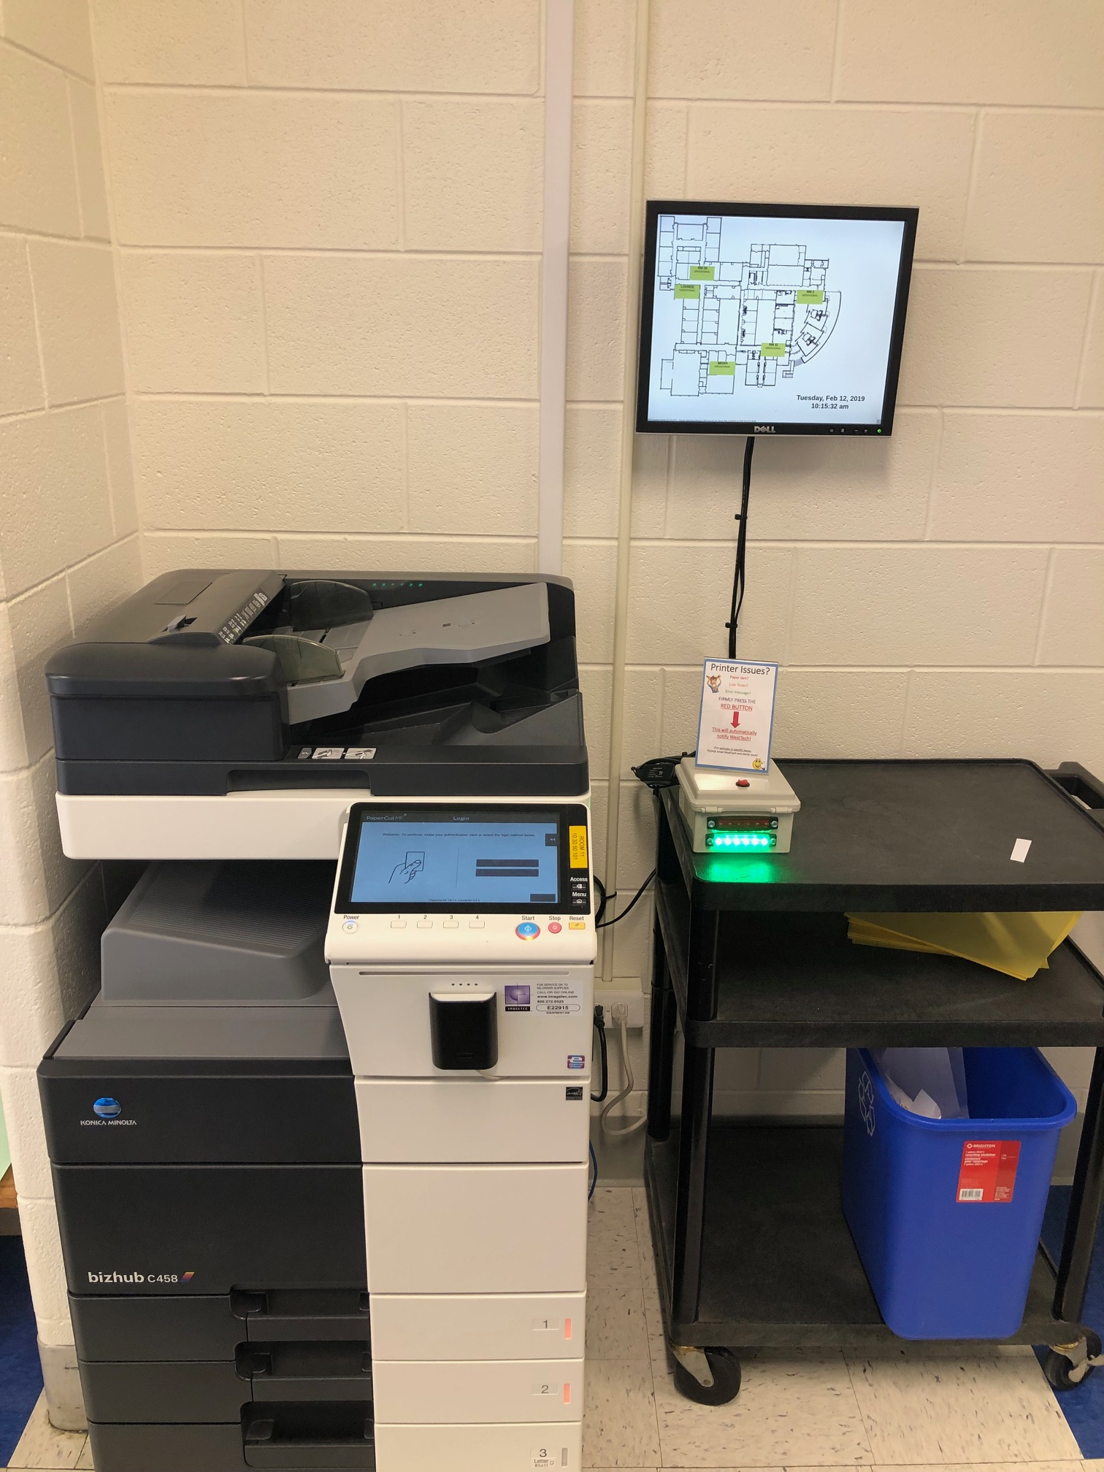

Slide 59
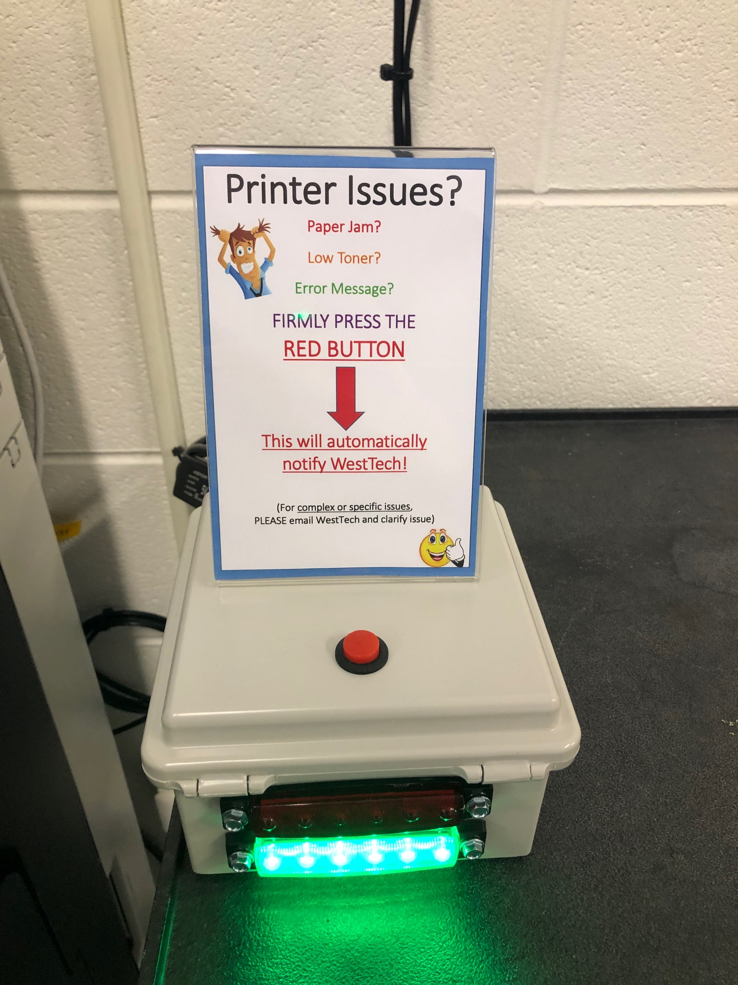
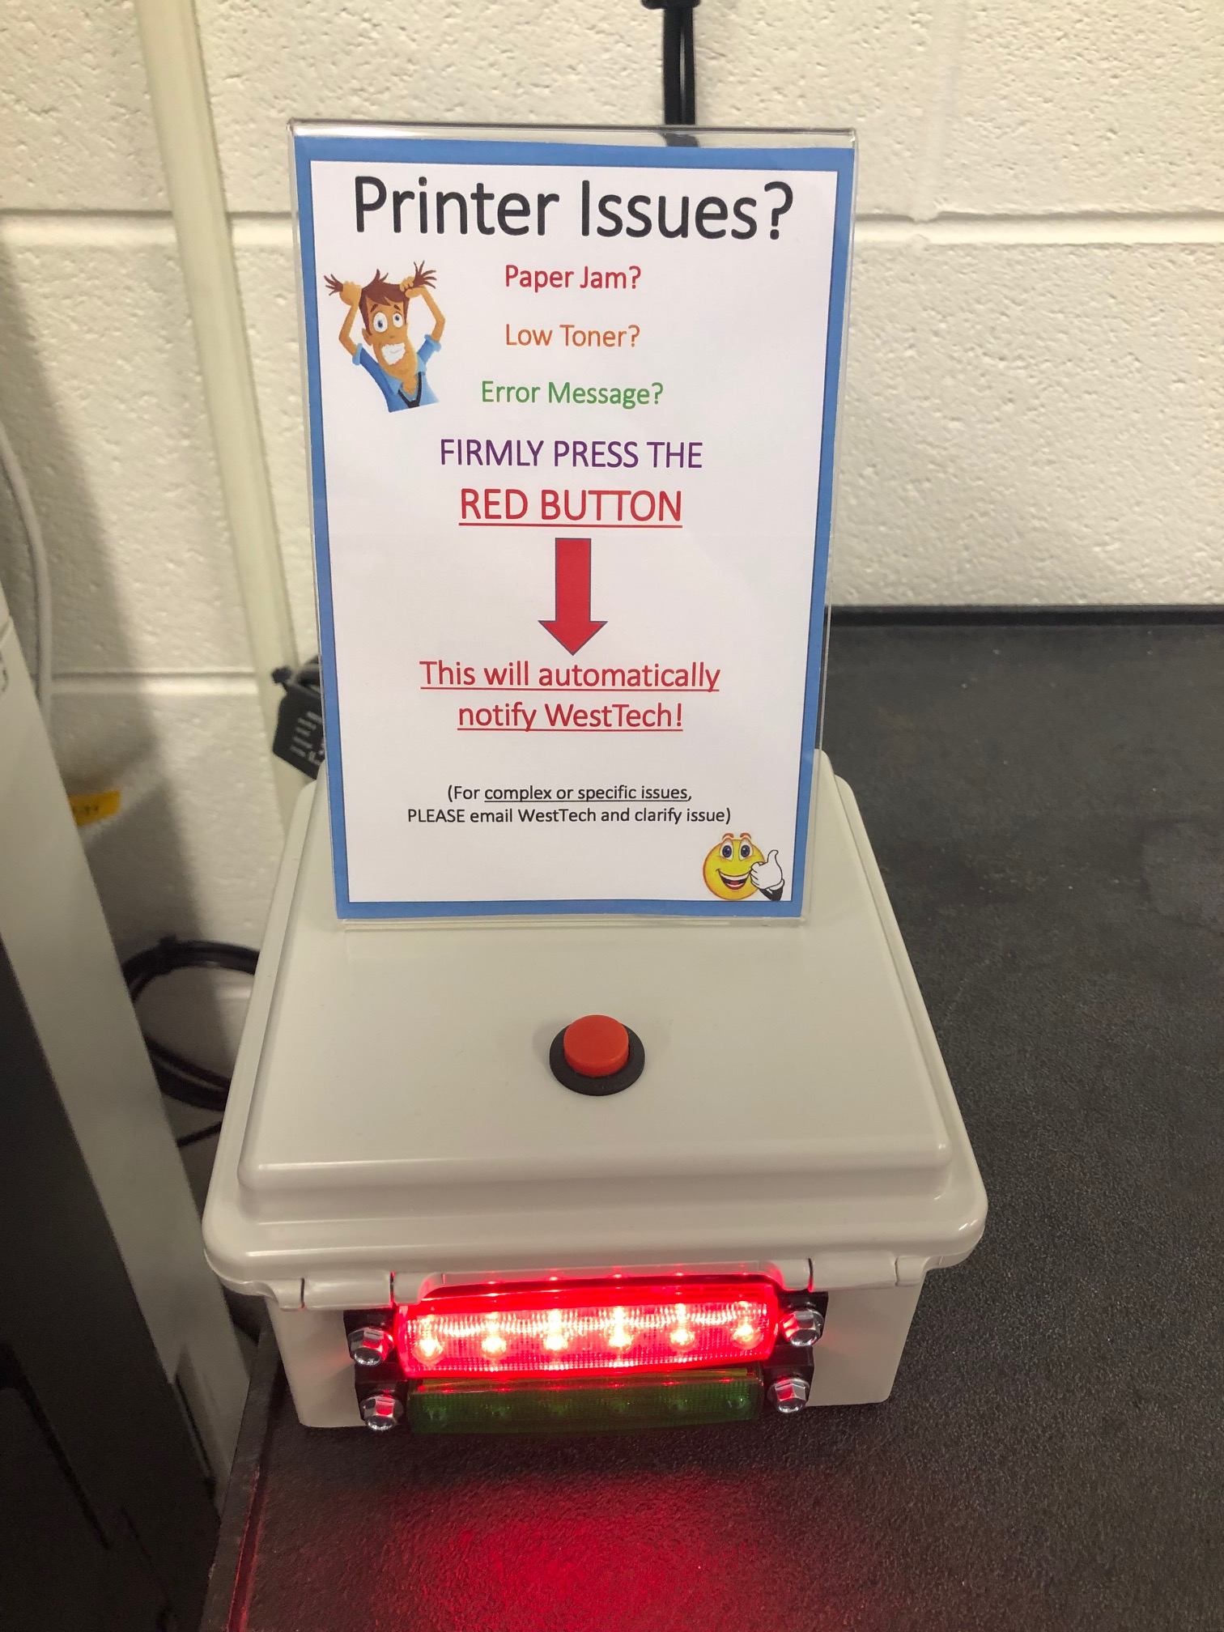

Slide 60
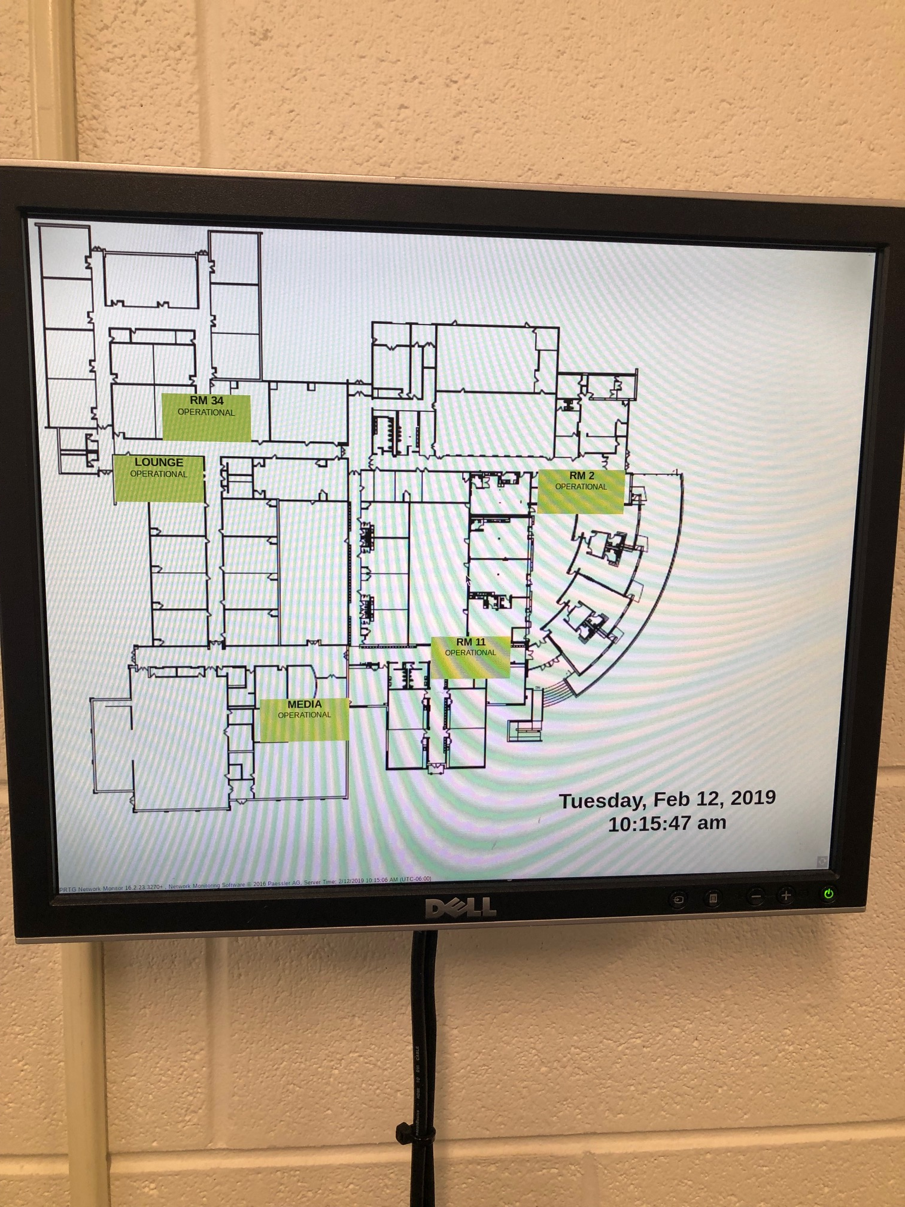
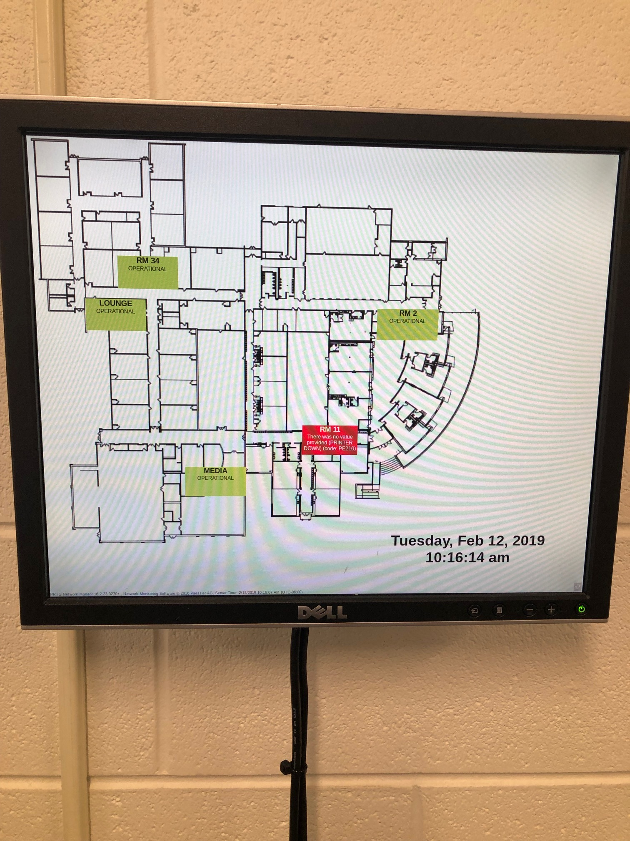

Slide 61
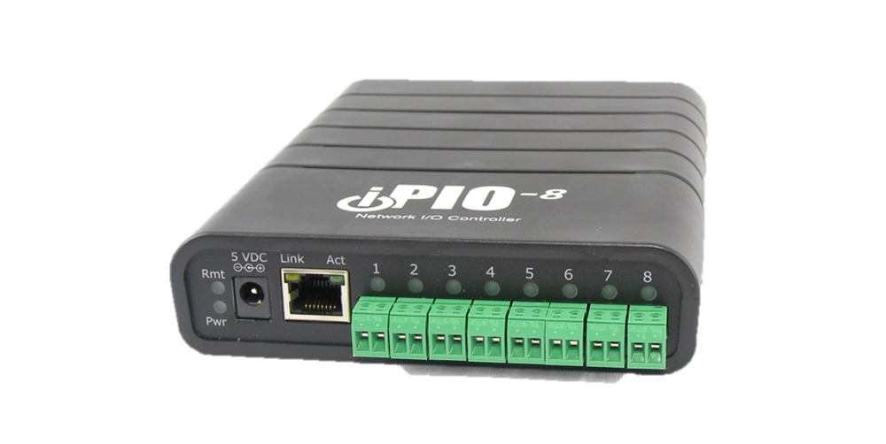
IPIO
Dataprobe IPIO Device
Offers network controlled relay
2 port - $235
8 port - $395
16 port - $595
Fire alarm, lockdowns, access control, status monitors, etc
SNMP, can link to PRTG for status
Built in SMTP, can email/text
Can bridge two together for remote sites. School zone lights, remote indicators, district office monitors, etc

Slide 62
Scripts
Computer Shutdown Nightly
Computer Wake On LAN
Reboot Unifi APs
Run Updates
Volume: Unmute and set at 75% for PARCC/MAP
Delete Printers
Delete Public Desktop
DelPro Groups
Windows Update Groups

